Slide 1
Analysis of different methods to approach and solve Hidden Markov Models.
By : Prayag Jain (170001037)
Yasasvi V Peruvemba (170002061)

Slide 2
Contents
Hidden Markov Models
Forward Backward Algorithm
Time Complexity Analysis
Viterbi Algorithm
Time Complexity Analysis
CarpeDiem Algorithm
Time Complexity Analysis

Slide 3
Hidden Markov Model

Slide 4
Definition
Hidden Markov Model (HMM) is a statistical Markov model in which the system being modeled is assumed to be a Markov process with unobserved (i.e. hidden) states.
Hidden Markov models are especially known for their application in reinforcement learning and temporal pattern recognition such as speech, handwriting, gesture recognition, part-of-speech tagging, musical score following, partial discharges and bioinformatics.

Slide 5
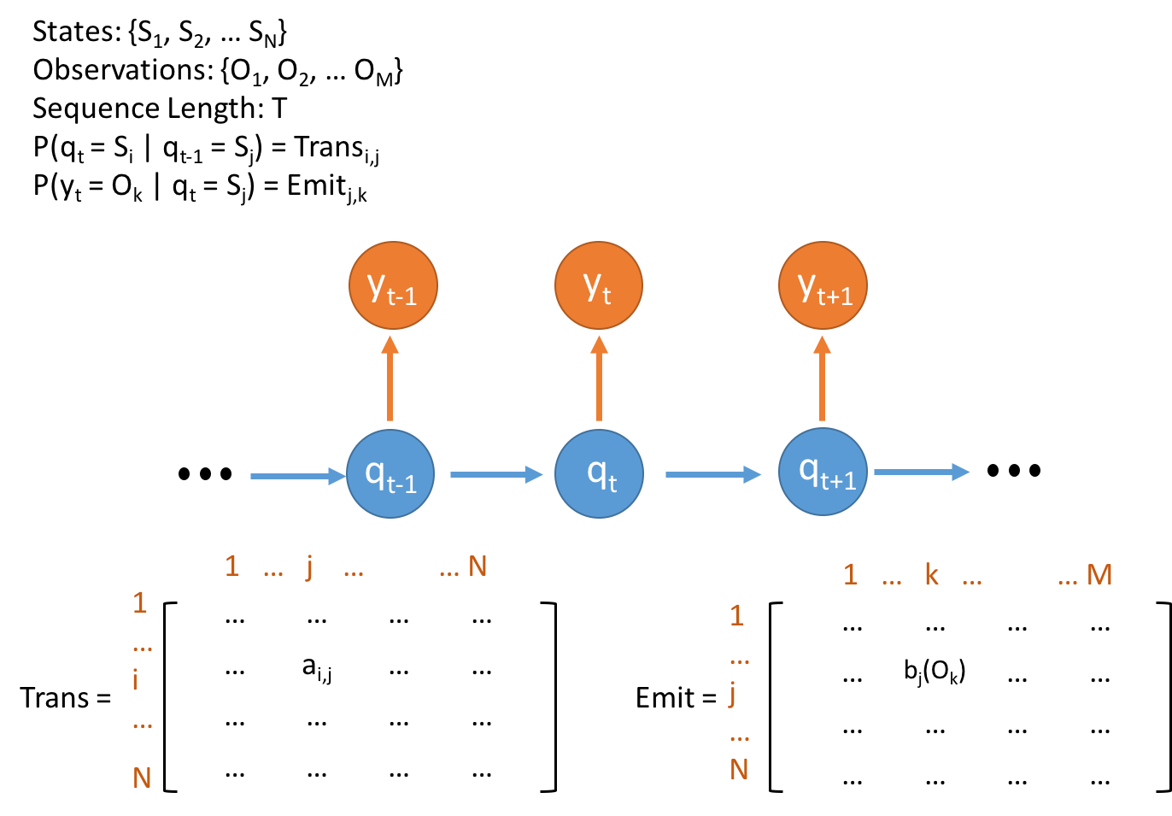
Properties of HMM’s

Slide 6
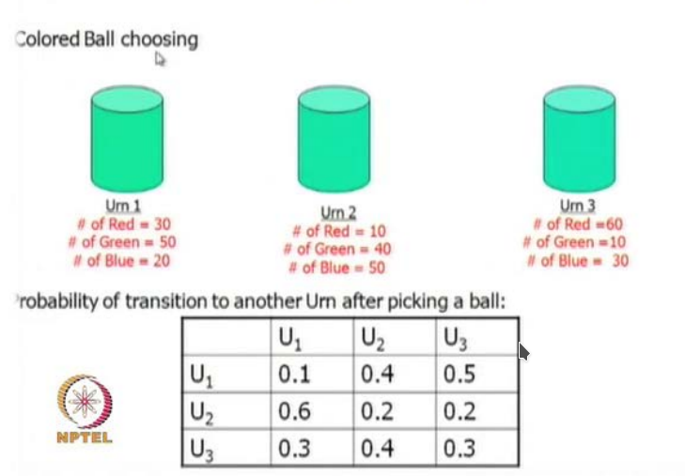
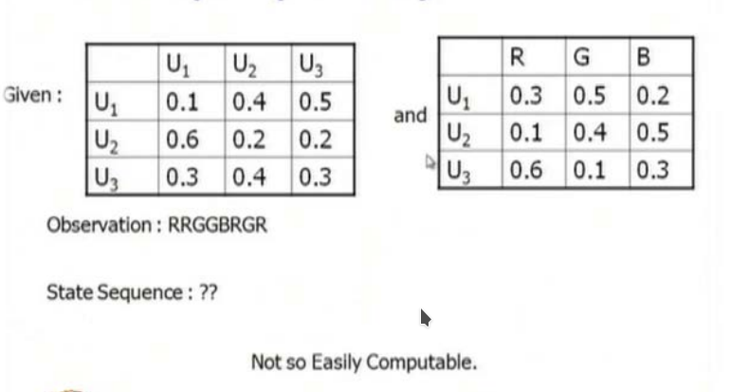
A Motivating Example

Slide 7
Viterbi Algorithm

Slide 8
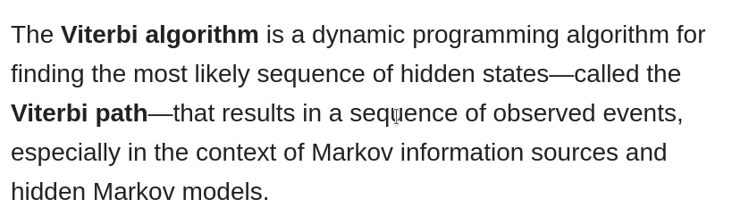
Definition

Slide 9
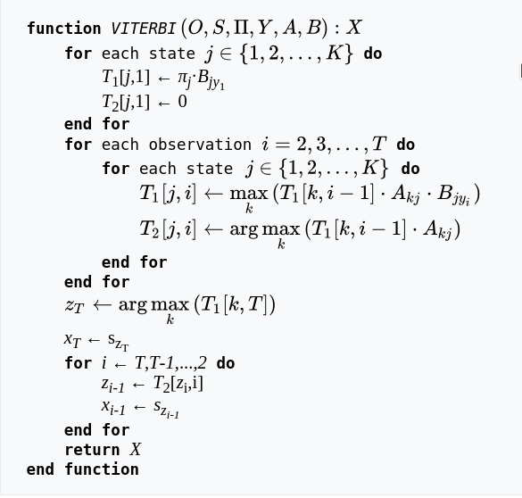
Pseudocode
Viterbi C++ Implementation

Slide 10
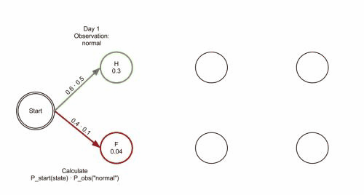

Slide 11
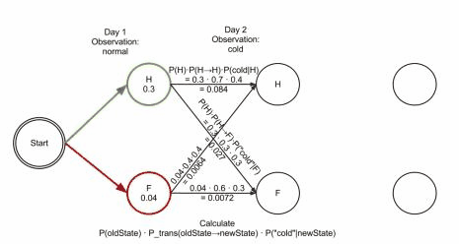

Slide 12
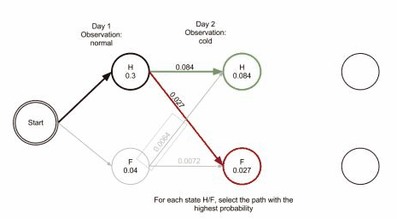

Slide 13


Slide 14
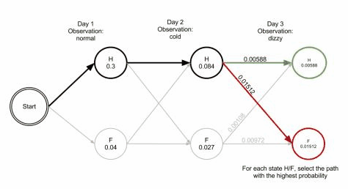

Slide 15
The Time complexity of this algorithm is
O(NT^2)
And the space complexity is
O(T^2 + kT + NT)
K is the total number of unique observable states.
T is the total number of unique hidden states.
N is the length of the observed sequence.
Time
Complexity

Slide 16
Forward & Backward Algorithm

Slide 17
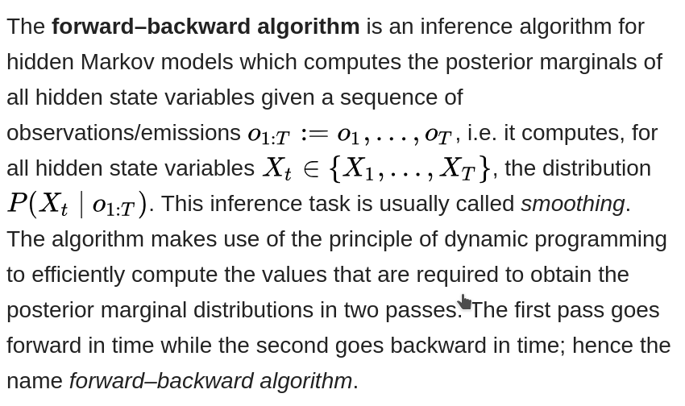
Definition

Slide 18
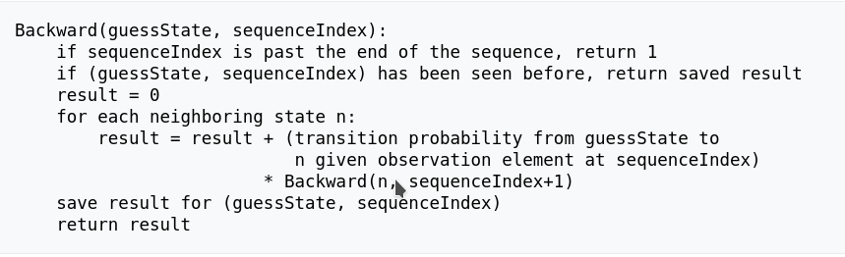
Pseudocode (Backward)
Forward Backward C++ Implementation

Slide 19
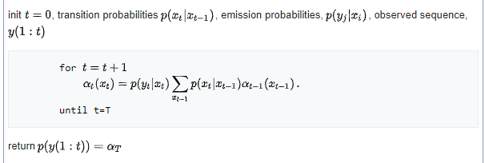
Pseudocode (Forward)
Forward Backward C++ Implementation

Slide 20
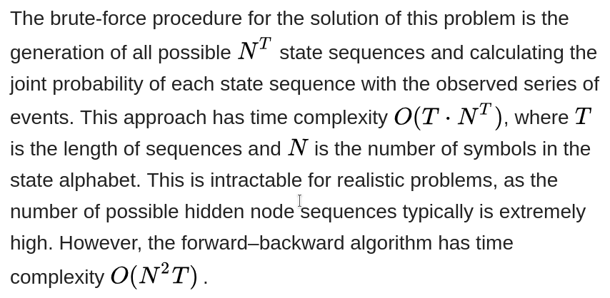
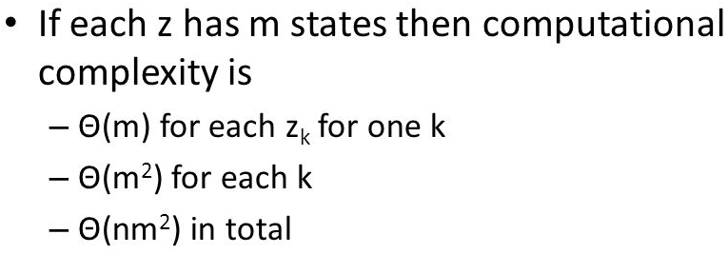
Time
Complexity
z ∈ Hidden States in a layer
m is the set of Hidden States
n is the length of observed sequence

Slide 21
CarpeDiem Algorithm

Slide 22
Definition
In order to determine the end point of the best path to a given layer, one can avoid inspecting all vertices in that layer. In particular, after sorting the vertices in layer t according to their vertical weight, the search can be stopped when the difference in vertical weight of the best node so far and the next vertex in the ordering is big enough to counterbalance any advantage that can be possibly derived from exploiting a better transition and/or a better ancestor.

Slide 23
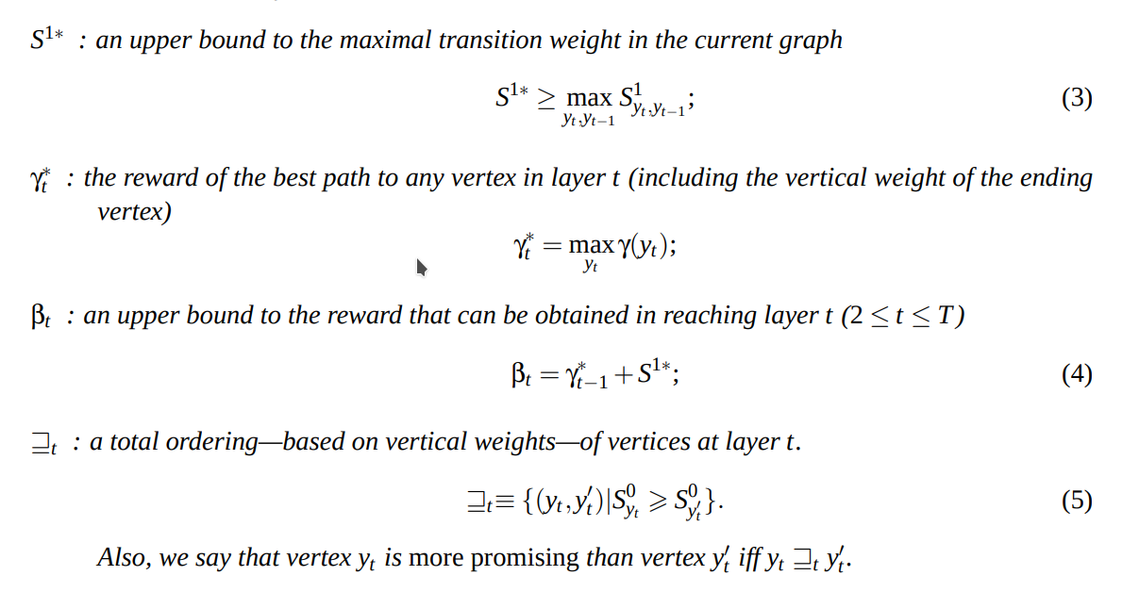
Lets Define

Slide 24
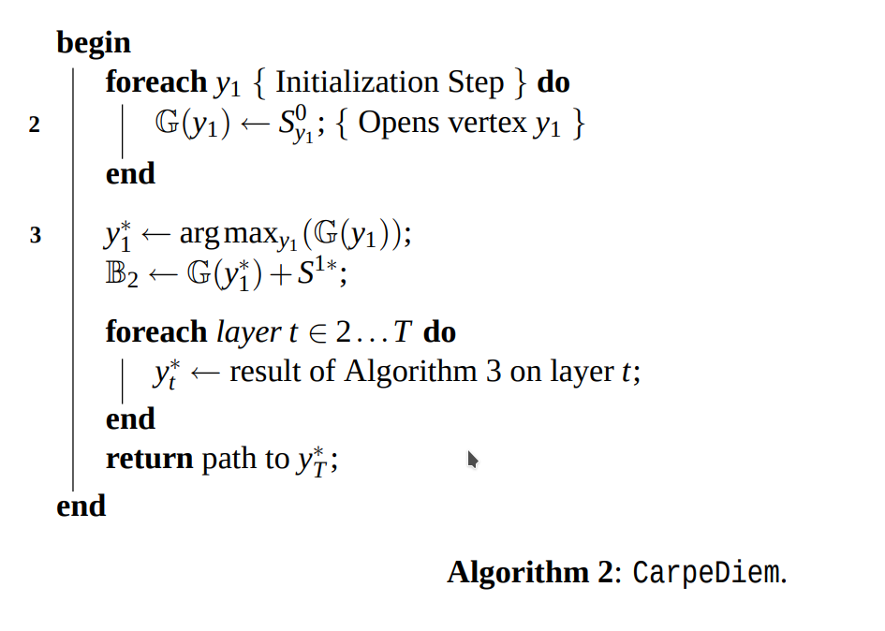
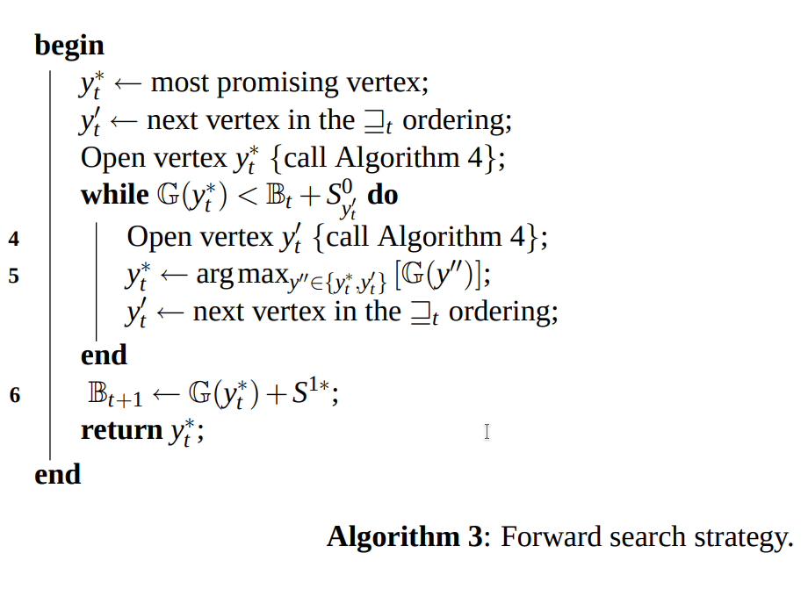
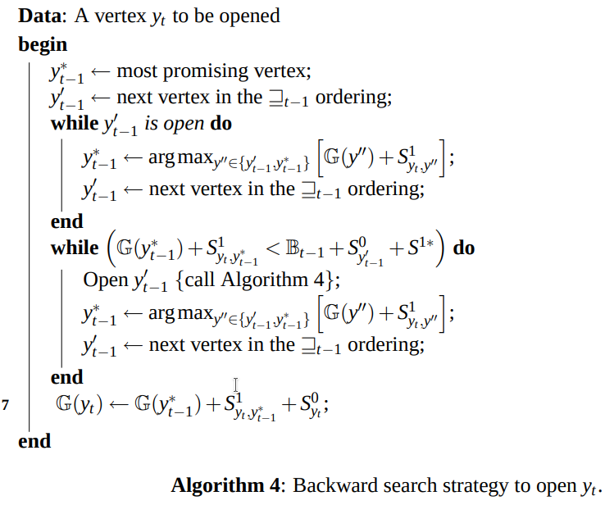
Pseudocode (CarpeDiem)

Slide 25
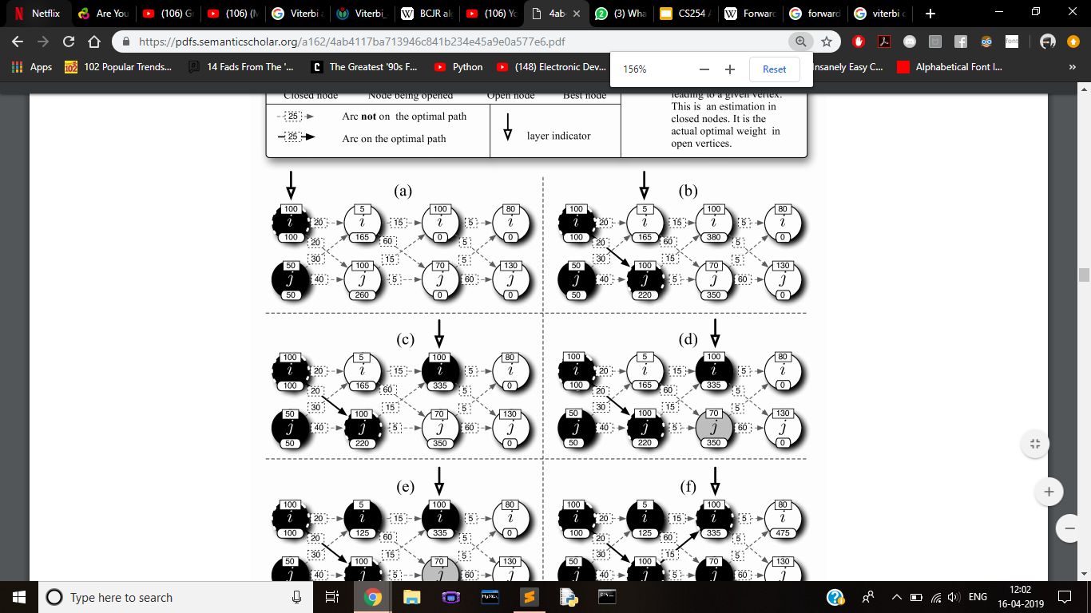

Slide 29
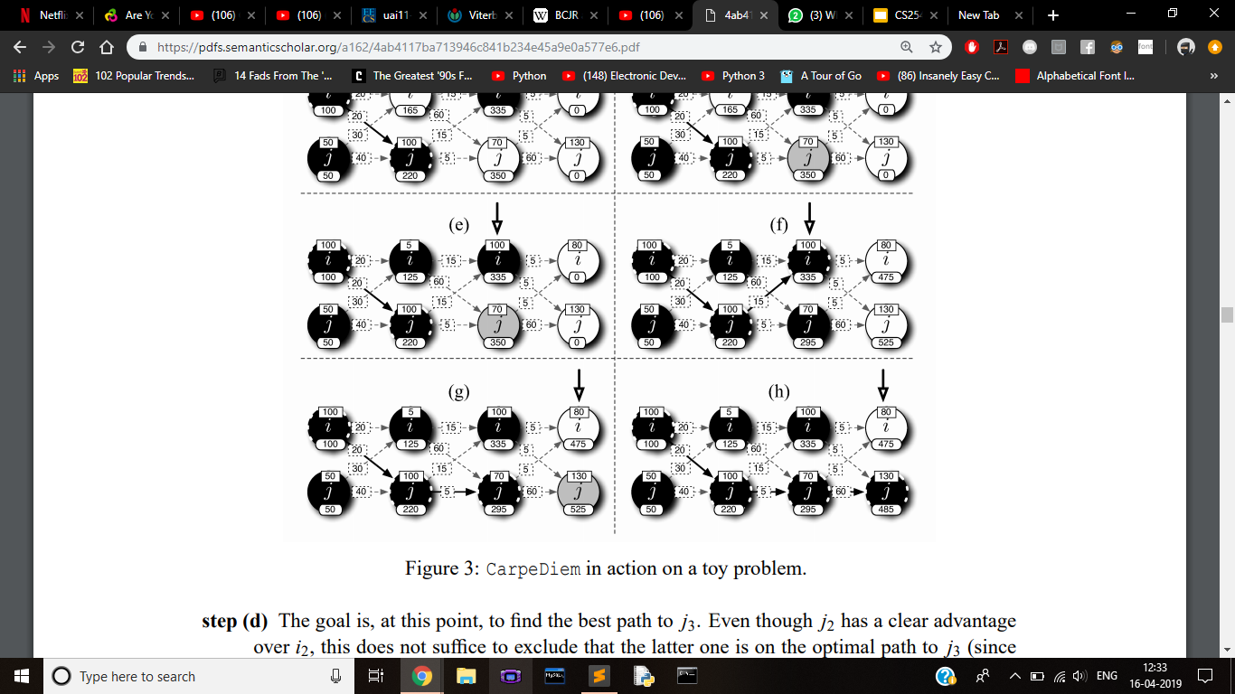

Slide 33
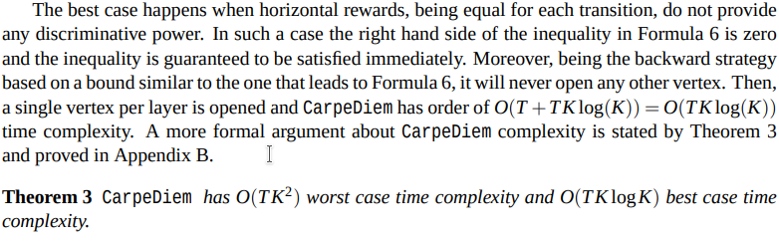
Time Complexity

Slide 34
Thank You!!

